Slide 1


TREAP

Slide 2
Content Page
Introduction of Treap
Insert Element in Treap
Delete Element from Treap
Minimum to Maximum Traversal
Maximum to Minimum Traversal
Split Treap
Merge Treap
Applications of Treap
Complexity
Conclusion

Slide 3
Introduction of Treap
A treap (= tree + heap) is a combined binary search tree and min or max heap.
A treap simultaniously satisfies the binary search tree property and the heap property.
Becasue it relies on random values, a treap is a probabilistic data structure.
BST properties with respect to keys
-Larger than all keys in the left subtree
-Smaller than all keys in the left subtree
Heap property with respect to priorities
- Larger than all priorities below
- Smaller than all priorities below

Slide 4
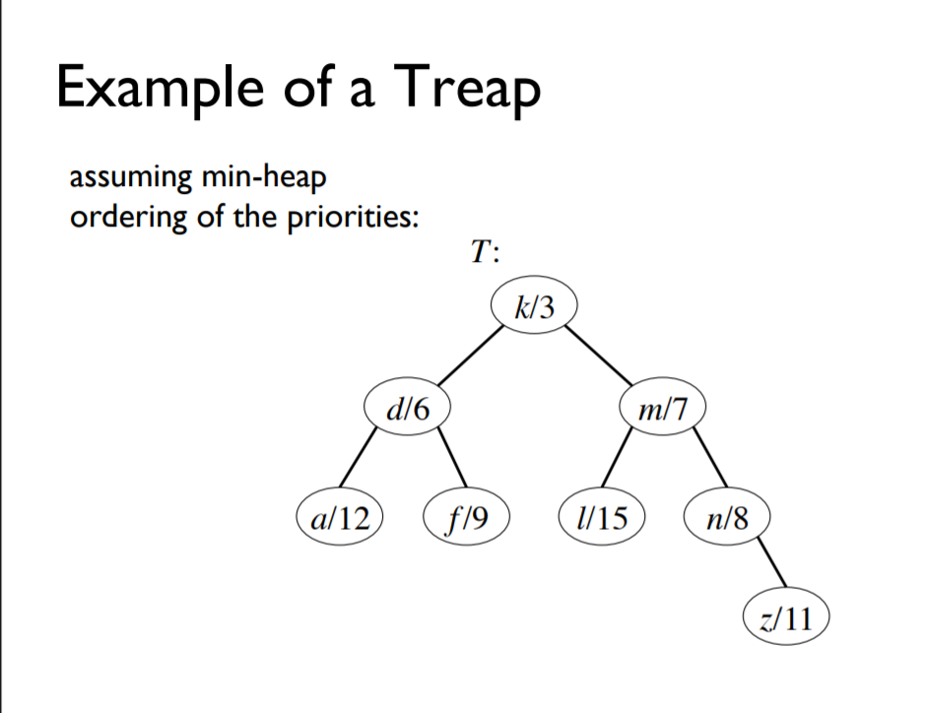
In figure-1,
key= k, d, m, a, f, l, n, z
Priority = 3, 6, 7, 12, 9, 7, 8, 11
Here all the keys maintain BST property
Besides, all the priorities maintain heap property.
So, it’s a perfect example of treap.
Figure-1

Slide 5
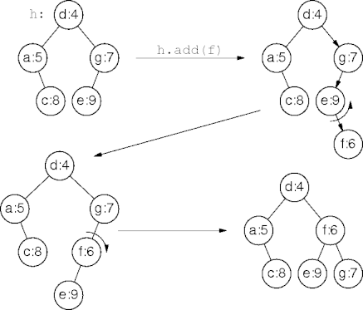
Treap Insertion
Insert the new tree value into the treap to preserve the binary search tree property.
Assign the new tree value a unique random heap value.
Use node rotations to bubble up the new heap value to re-establish the heap property if necessary.
Maintaining the bst property
Treap nodes rotate to maintain the heap property.
Figure-2 (Example of Treap Insertion)

Slide 6
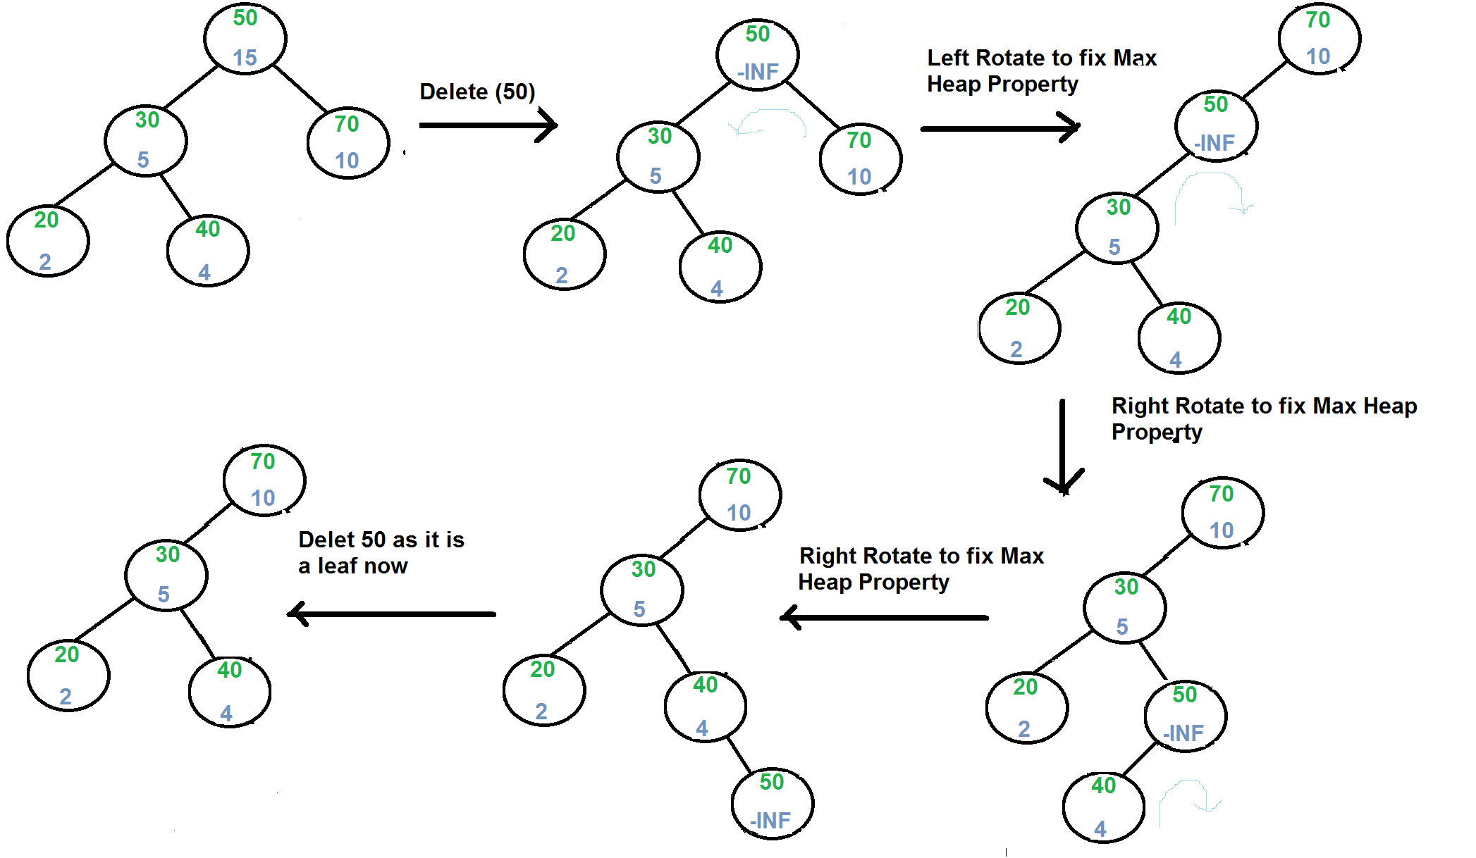
Delete Element from Treap

Slide 7
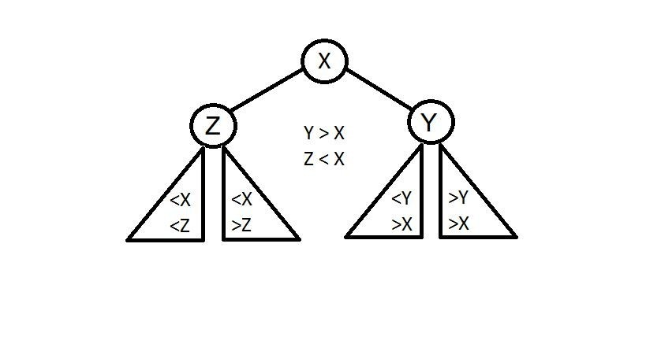
Split Treap
if key >= X​
Call the split function for Y and attach the root of L' returned by this split as right child of X
L will still be heap ordered coz priority of all elements in Y is < X.
L will still be BST ordered coz all elements in Y > X.
Also, R of X = R' returned by split on Y.
else if key < X
Call the split function for Z and attach the root of R' returned by split as left child of X
Also L for X = L' returned by split of Z .

Slide 8
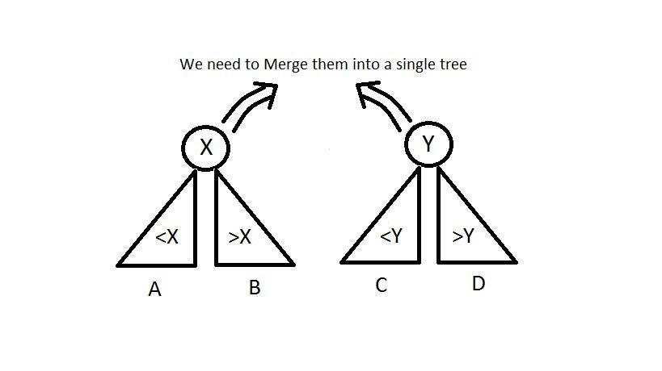
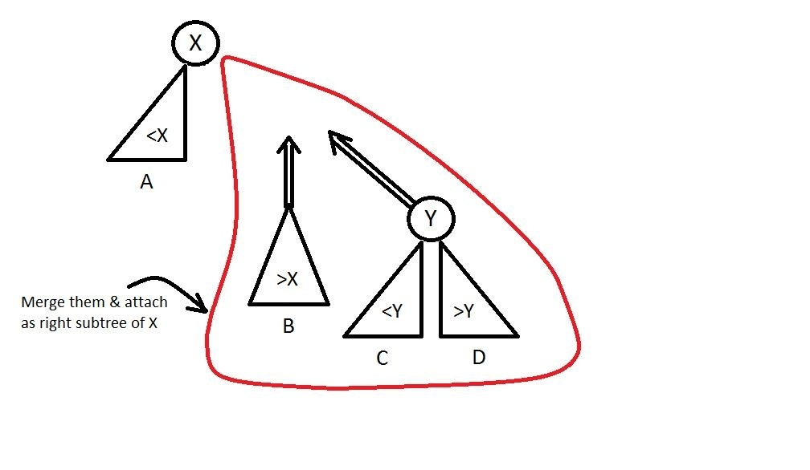
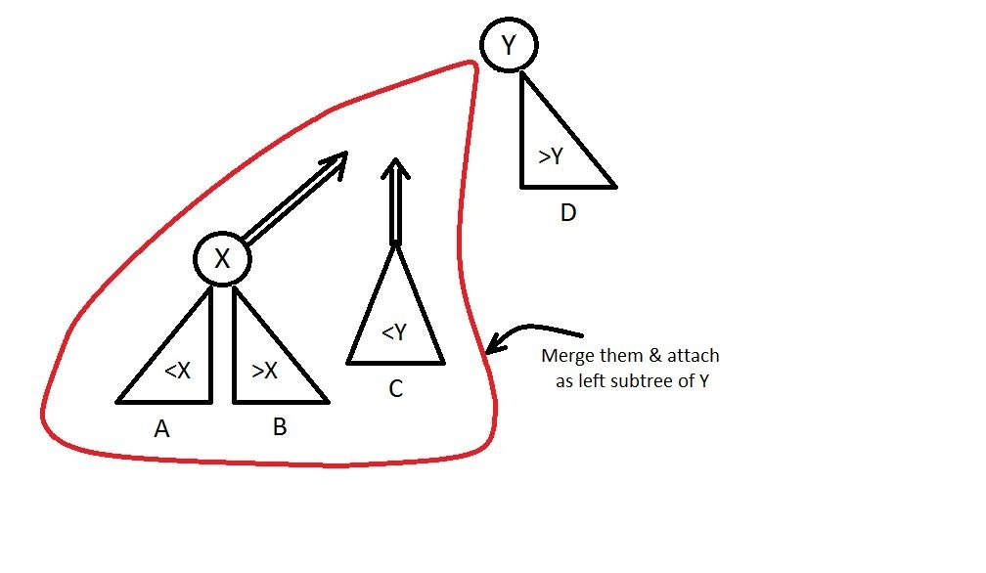
Merge Treap
How to choose the new root ? (assuming that we are following max-heap property)
if(priority(x) > priority(y))
else if(priority(y) > priority(x))

Slide 9
Applications of Treap
Treap is used as a self balancing binary tree.
Treap is used to solve connectivity problems.
Security reasons. A treap can not contain information on history.
Treap is also Efficient sub tree sharing.
The fastest algorithms for set operations I have seen use treaps.

Slide 10
Complexity
Spacecomplexity:O(N)
Timecomplexities:O(N)
Search:O(log2N)
Insert:O(log2N)
Delete:O(log2N)

Slide 11
“Programming allows you to think about thinking, and while debugging you learn learning.”
-Nicholas Negroponte

Slide 12



